Slide 1







10 Practices for a Healthy DevOps Life
Richard Fennell CTO Black marble
Notes:
By the end of this session you might think ‘well we do all that’ and that’s great
But too many organisations don’t
I am still surprised the out consulting that things I think as basic are new an radical
Hope today this is not the case, as anyone giving up weekend is engaged
But just because you know it is a good idea does not mean you do it

Slide 2


1. Source Control
Notes:
Your safety net
All tried a test/refactor and messed it up and need to go back
Today you would consider this ‘table stakes’
But not always present (IT and scripts)
True to say Git is now the defacto standard irrespective of provider
But it does everyone know how to use the tools (
True in Git, maybe more than any other scc as there are less options?
This is particularly true for students new hire – there is not much source control taught
Source Control if enabled can be part of protection from human error
Enforcing rules e.g. branching/merge – requiring pull requests – not a git feature but by providers
More of that later….

Slide 3

2. Work Tracking
Notes:
Does not have to be technology – but you need to know what to do and in what order
All systems trying to be as good as a postit notes
Good if it can be linked to source control for audit
This is where process come in
Waterfall vs Agile
Scrum
Kanban
Putting arguments side over process, all tend to stress
Short delivery cycles
Focused teams/delivery
Close relationship with client

Slide 4

3. Continuous Integration
Notes:
Build has always been important
Story me in 80s writing Pascal for HP Mini were doing night builds
One of the first appearances in Kent Beck in XP books of whole system
Today I would hope we do better
Make CI Heart beat of a project
Every commit (or at least PR) should be tested it can be build
THIS IS IRRESPECTIVE OF LANGUAGE
Just because you don’t need to compile do still Lint or equivalent
So much can be hung off this a team/project matures (we will keep coming back to it)

Slide 5

4. Continuous Delivery
Notes:
Defined types of CD
Continuous delivery automates deployment of a release to an environment for staging or testing
While continuous deployment automatically deploys every release through your pipeline (including testing) and to production. Continuous deployment is an extension of the continuous delivery concept
CD is enabled
By small releases
Feature flags help
Build trust on how you can release
Like CI it is a core technology that can have other items added into it

Slide 6

5. Infrastructure as Code
Notes:
A major barrier to innovation has always be time to provision hardware
The time form ‘loading dock to machine room’
Story – worked project to move updates measure in months to hours
Normally when we talk about IAC we are meaning with cloud
Where the rental model means it is easy to buy only what you use
Vendor agnostic like Teraform, or vendor ARM/Bicep
Should be able to ‘stamp’ out a complete instance of your system
Lint in CI
Deploy in CD
But if on prem still can use some of these technologies if running VMWare Hyper V
We use Lability to automated provision of complete enviroments on Hyper-V

Slide 7

6. Automated Testing
Notes:
Can be at any level from Unit to UX
Invest in the lowest level tests that work for your needs
Wire into CI and CD

Slide 8

7. Supply Chain Analysis
Notes:
Loads that can be done in CI/CD
Range of Tools
SonarCloud
Synk
GitHub Advanced Security
Vulnerabilities tracking
Dependabot

Slide 9

8. Documentation
Notes:
Documentation can mean many thing.
The danger is it is an after thought
Need to make up to date and easy to consume (be in the right place)
Automate its product as part of CI/CD process
Use example of my extension

Slide 10

9. Exploration
Notes:
Core to agile process
Can try out any part of the system to improve it
Embrace your inner toddler
Story of how adding CI?CD makes exploration cheaper

Slide 11

10. Buy in
Notes:
Team and C level management

Slide 12

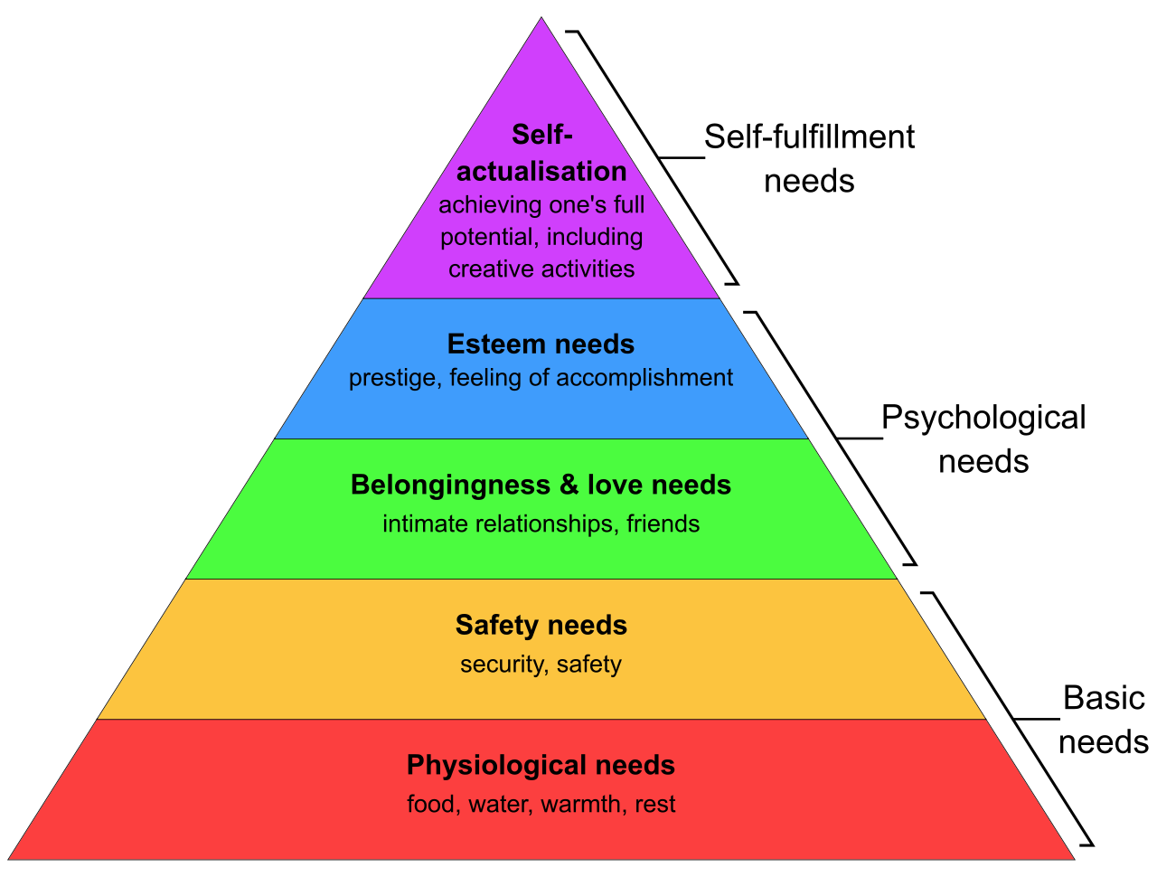



Maslow’s Hierarchy Of Needs
Notes:
Though can consider the items I have called table stakes – the lower level?
Maybe look at them as levels of maturity
There is a mapping but it is open to teams view as which is correct for them,

Slide 13
“ Culture Eats Strategy For Breakfast ”
Peter Drucker
Notes:
Supposedly said by Peter Drucker the management guru in 2006 (origin in dispute)
IBM, General Motors, and Procter & Gamble – basically created moder enterprise structures
Culture tends to comes first
No good being able to release each day, but only if management/business only allows quarterly
Looking from the other end Alistair Cockburn ‘Crystal Clear: A Human-Powered Methodology for Small Teams’ talks about a system needs to be Habitable
Sneak stuff in – was there a name for that

Slide 14






Richard Fennell
Chief Technology Officer (Black Marble)
MVP (Developer Technologies)
FBCS CEng (BCS)
rfennell
richardfennell.bsky.social
blogs.blackmarble.co.uk
richard-j-fennell
@RichardFennell
@rfennell@techhub.social
Images in this presentation created by Microsoft Copilot

